Slide 1
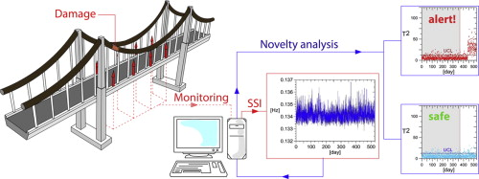
RTOS-Based Structural Health Monitoring System
Using Vibration Signature Analysis
EMBEDDED SYSTEMS

Slide 2
The Problem with Traditional Inspection
Periodic & Manual
High Cost of Failure
Inspections are infrequent — damage can develop undetected between cycles
Undetected structural damage leads to catastrophic failures and massive economic loss
No Continuous Monitoring
Existing methods lack real-time, automated, low-cost early-warning capability

Slide 3
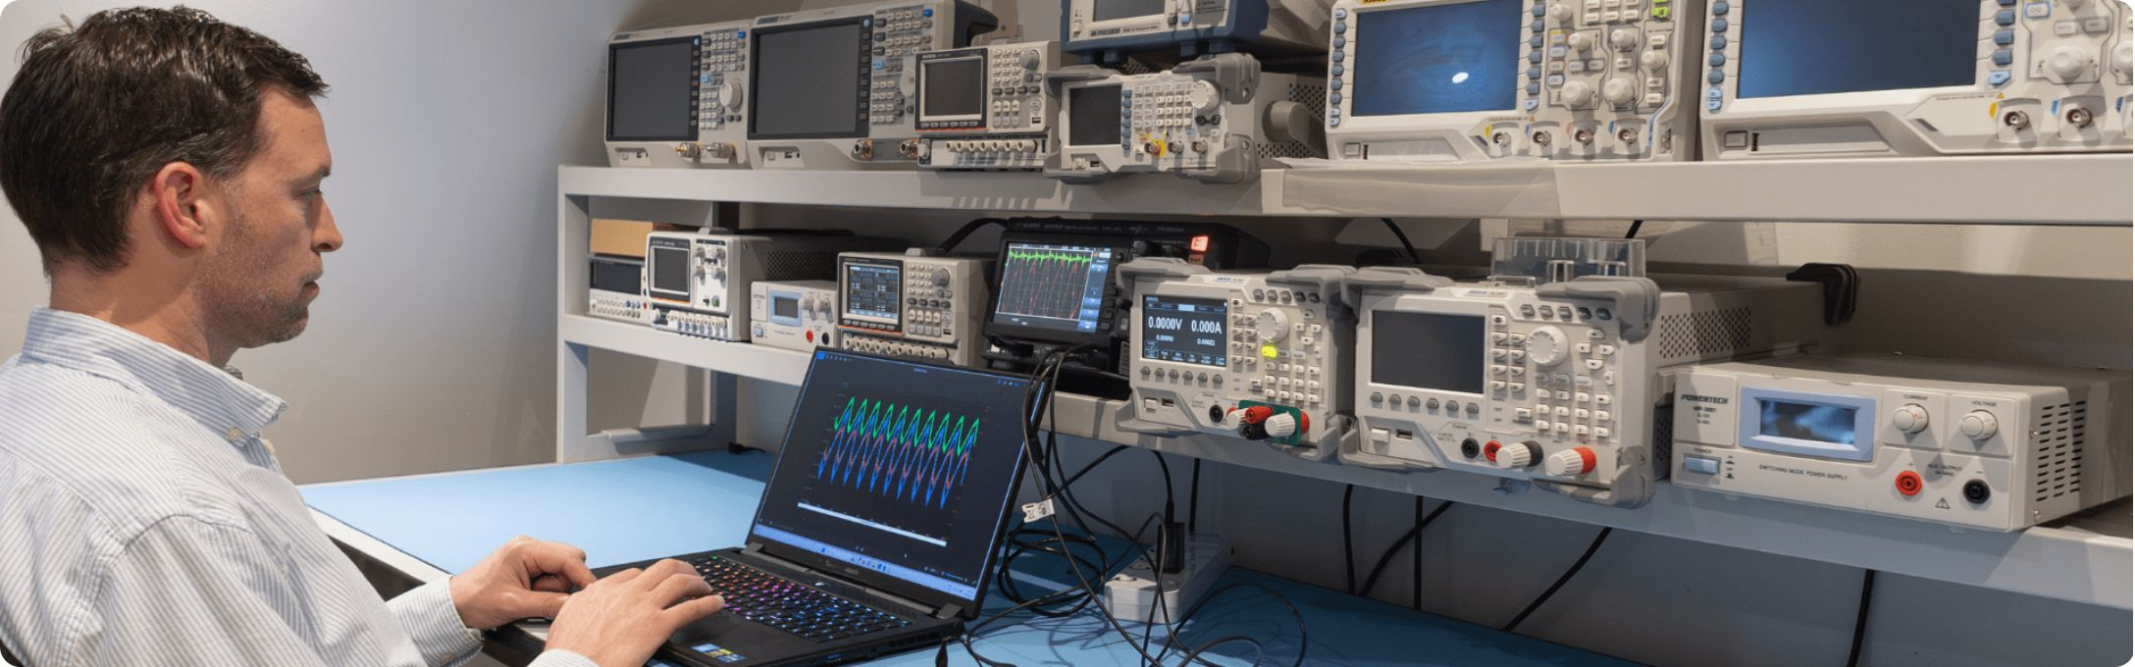
Project Objective
What We Are Building
A low-cost, real-time, RTOS-based system that detects early-stage structural damage through vibration signature analysis.
Multi-point vibration sensing using ADXL345 accelerometers
FFT-based frequency domain analysis on ESP32
Deterministic scheduling via FreeRTOS
OLED + WiFi alert output

Slide 4

Proposed System Architecture
STM32 FFT Processing
TCA9548A Multiplexer
3× ADXL345 Nodes
Three spatially distributed accelerometer nodes feed synchronised vibration data through an I2C multiplexer to the ESP32, which runs FFT analysis and triggers alerts upon detecting signature deviations.

Slide 5
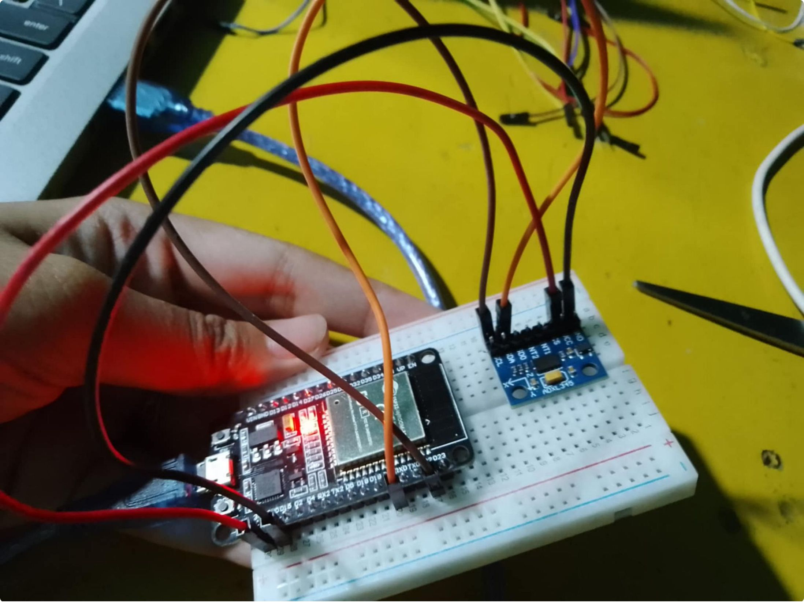
Hardware Components
Component
Role
Qty
STM32
Main MCU
1
ADXL345
3-axis accelerometer
3
TCA9548A
I2C multiplexer
1
0.96" OLED
Local display
1
Cantilever Beam Rig
Scaled test model
1
Estimated total cost: ₹1,800 – ₹2,200

Slide 6
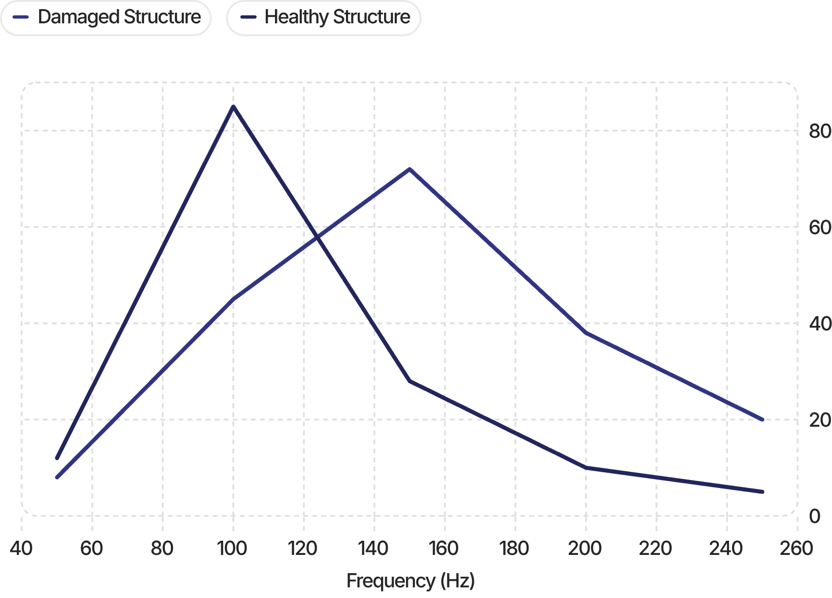

Expected Results: FFT Signature Comparison
Interpreting the Shift
A damaged structure exhibits:
Shift in dominant natural frequency peak
Emergence of new harmonic components
Reduced amplitude at primary resonance
Detection accuracy target: >90% · Response latency: <100 ms

Slide 7
Applications, Novelty & Future Scope
Applications
Novelty
RTOS-based deterministic multi-point modal analysis vs. simple threshold alarms.
Civil Infrastructure
Bridges, buildings, flyovers
Future Scope
ML-based damage classification
Cloud dashboard integration
Industrial
Machinery, trusses, towers

